Slide 1
Following the Dalmatian Standards Around the World 1905 - 2011
Tim Robbins
May 1, 2011

Slide 2
Key Points
Comparison Standards and Historical Background
AKC (1989)
UKC :United States (2010)
Canada (2009)
UK: England (2009)
Australia (1993)
FCI: Federation Cynologique Internationale (1999)

Slide 3
Versions of the AKC Dalmatian Standard
1915
1950
1962
1989 (current version)

Slide 4
Historical Dates Affecting AKC Dalmatians
1883—Dalmatians were first shown in the United States.
1888---AKC recognizes Dalmatians as a breed.
1896---“Not until the year of 1896 were classes opened at eastern shows with very little support until four years ago when with some homebred ones and some imported ones the entry was very good” (1) p. 7 The Dalmatian by H. Fred Lauer, copyrighted 1907
1905---Formation of the DCA. It started with 26 members, and now has an enrollment of 46 members, and today is one of the strongest specialty clubs in America. (1) p. 10
Dalmatian Standard published in July, 1915 AKC Gazette. (English version)
1926---DCA held its first national specialty in Garden City, Long Island, with a total of 19 entries.

Slide 5
Westminster Kennel Club Catalog 1906 (British)
Courtesy of Jim Crowley

Slide 6
AKC Gazette July 1915
Courtesy of Jim Crowley

Slide 7
Historical References to the Unacceptable Colors in Dalmatians
Excerpt from The Dalmatian by Fred Lauer, 1907, page 32:
“Markings---“The Dalmatian is a very handsome and striking dog with a snow white body, that should be as evenly and clearly marked as possible with black or liver spots. The two colors, may be on the same dog but should not mix or be mixed with white. Often we see dogs on which the spots are mixed with much white. This makes the spots look bluish, and is called Huckleberry marking and is not at all desirable. It often occurs he has liver or tanned spots on his legs and about his neck.
Excerpt from The Dog Book by James Watson, 1905, Doubleday, page 339.
“With regard to colour, unless called upon to judge under a particular standard, we should not penalize a dog for black ears, nor for tan spots on the legs or cheeks, for these we know to have been proper Dalmatian colourings from the very first of our information regarding the breed up to the time these English clubs were started, and there is no reason why the change should have been made. ….We have never seen any Dalmatian, to our mind, the equal of the renowned Captain in the matter of distinctness and regularity of spotting. He was unbeatable in his day, and had tan spots on his legs, which were thought most attractive too.
Excerpt from The Dalmatian by Franklin J. Willock, 1927, Ernest R. Gee, page 21.
“ Edward James writes in America in 1873 “the color is either black, liver or dark blue. Sometimes there is a strain of tan about the head and legs, which is not objected to. A clear black is more highly valued than black and tan, the liver and blue being of equal value.

Slide 8
Early Dalmatian Standard (pre-1921)
The Dalmatian by Fred Lauer p.13—”The following is a description and standard recommended by the American Dalmatian Club, and is that of the English Dalmatian Club, but is not one to the liking of a great many members of the club, and we hope in the future it will have various changes, for it is not all suitable for the purposes of letting a novice know what is wanted or needed in a true type Dalmatian”
Note: Neither the English nor the American versions of the Dalmatian standard contained a description of proper gait or movement.

Slide 9
Early Standards (cont)
From Lauer’s book (p38) ---”Often the dalmatian is seend with what is called “China” or “Moon,” or “Glass”, or “Wall” eyes, a peculiarity frequently appearing in all varieties of dogs, or animals that have much white about them, and where white is mixed with black, or what is often call “blue”. Personally I do not consider this eye detracts from the animal’s appears”
At this time both English & AKC standards list size as 19-23 inches.
Neither standard contains “Faults” or DQ’s at this point.

Slide 10
The Purpose of a Breed Standard
The purpose of a standard is to be a guide for breeders and judges.
It is important to keep in mind those features that make the breed unique; those qualities that make the breed unique; those qualities the breed must possess to do the job for which it was created.
A standard should emphasize what is important in the breed.
Conversely, those qualities that of little or no importance are mentioned only in passing, or not at all.

Slide 11
Standard “Facts”
The breed standard belongs to the Parent Club.
But it must be approved by the American Kennel Club.
This also applies to any changes or revisions to the breed standard.
Breed standards can no longer make reference to another breed in its standard. For instance, “Head should be of fair length, the skull flat, rather broad between the ears and moderately well defined at the temples, i.e. a moderate amount of stop and not in one straight line from the nose to the occipital bone, as required in a Bull Terrier . It should be entirely free from wrinkle. (1915, 1950 and 1962 versions of the Dalmatian standard, approved by AKC.)

Slide 12
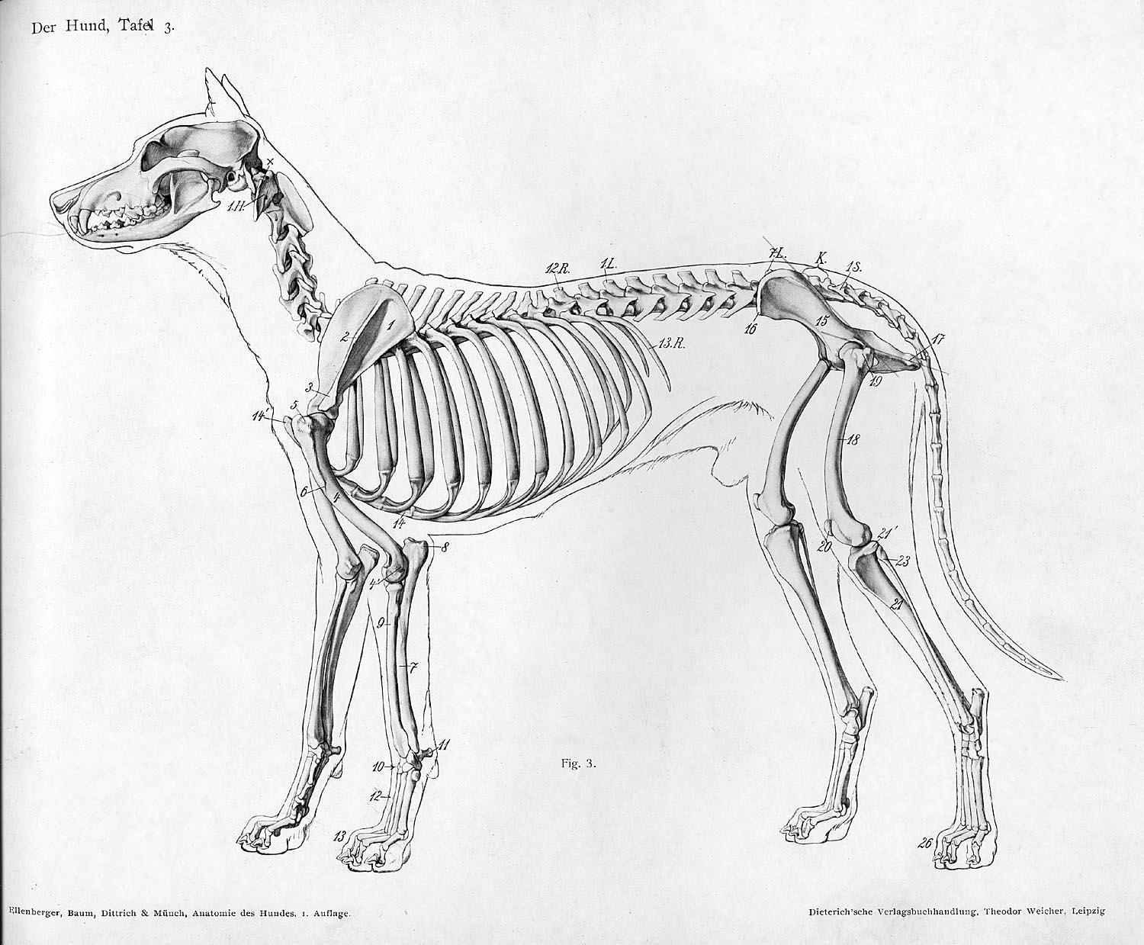
Canine Skeleton

Slide 13
Basic knowledge of anatomy
When reading any breed standard, a person needs a basic knowledge of dog anatomy to fully understand some of the terms listed in some breed standards.
Many standards use ratios when describing proportion of height to length. One needs to understand where such measurements begin and end, on the body of a dog.

Slide 14
Addition to 1950 Standard
Gait -- Length of stride should be in proportion to the size of the dog; steady in rhythm of 1,2,3,4 as in the cadence count in military drill. Front legs should not paddle, nor should there be a straddling appearance. Hind legs should neither cross nor weave; judges should be able to see each leg move with no interference of another leg. Drive and reach are most desirable.

Slide 15
Comparison of 1921 and 1950
1921 SCALE OF POINTS
Head and eye 10
Ears 5
Neck and shoulders 10
Body, back, chest, loins 10
Legs and feet 15
Coat 5
Color and markings 30
Tail 5
Size, symmetry, etc. 10
TOTAL 100
1950 SCALE OF POINTS
Head and Eyes 10
Ears 5
Neck and Shoulders 10
Body, Back, Chest, Loins 10
Gait 10
Legs and Feet 10
Coat 5
Color and Markings 25
Tail 5
Size, Symmetry, etc. 10
TOTAL 100

Slide 16
“Behind the Scenes of the 1962 AKC Standard Revision”
Brief DCA history before 1960.
Interview with Dr. David G. Doane (committee member) Personal memories.
Reasons for wanting to add DQ’s to the standard.
Letter from AKC to Standard Committee 2/8/62
(Thanks to Cheryl Steinmetz, DCA Historian)

Slide 17
Reasons for DQ’s added in 1962
Prior to 1962, the DCA had a relatively small membership, most of which lived on the East coast.
The only time dogs from the West coast competed with the East coast dogs was at Westminster. The majority of the West coast dogs were large.
The DCA standard committee wanted to enforce the preferred size of 19-23 inches listed in the Standard. The AKC, at this time, did NOT want any size disqualifications for height included in any standard. A letter from the AKC in February 1962, to the DCA reminded the committee of their position.
However, through persistence of the committee, the AKC did allow a height disqualification, but only if the height was 24 inches. The DCA reluctantly agreed.

Slide 18
Reasons for DQ’s (cont’d)
Prior to 1962, tricolors were still being shown, and winning. The DCA standard committee felt that this was wrong and added the DQ’s for tricolors and patches.
Cowhocked rears were a problem in the breed, so the committee added “Cowhocks” as a major fault.
Incomplete pigmentation was also added as a major fault.

Slide 19
1962 AKC Standard for the Dalmatian Changed from the 1950 version
This version of the AKC Standard incorporated many important changes in wording, including faults and disqualifications.
The General Appearance statement was moved from the end to the beginning of the standard.
The descriptions of the head, muzzle, eyes, ears and nose were combined into one section.
1. The description of the bite appears for the first time. Added a disqualification for overshot or undershot.
2. Blue eyes are mentioned as acceptable for the first time.
3. Faults and Major Faults appear for the first time. ( Lack of pigment in eyerims and/or nose).
Neck and Shoulders—The word “moderately” is deleted from the shoulder description.
Body, Back, Chest & Loins. –Remains the same, except the word “moderately” is deleted in the description of “ribs well sprung.”
Legs, Feet & Nails--- Two sections are combined into one. “Dewclaws may be removed from legs” is added to this section . Additional wording added : “nails may be both black and white” and “nails may be both liver and white”.
Gait---Wording remains the same as 1950 version. Added: “Cowhocks are a major fault”

Slide 20
1962 Standard cont
Tail--- New wording: “Should ideally reach the hock joint” replaced “should not be too long”.
Deleted: “It should be spotted, the more profusely the better”.
Coat—Wording remains the same as 1950 version.
Color & Markings---Removed “the deeper and richer the black the better” and changed it to “dense black”. Added for the first time : “Patches, tri-colors, and any color markings other than black or liver constitute a disqualification. A true patch is a solid, sharply defined mass of black or liver that is appreciably larger than any of the markings on the dog. Several spots that are so adjacent that they actually touch one another at the edges do not constitute a patch.”
Size---Added for the first time—Any dog or bitch over 24 inches at the withers is to be disqualified. Wording remained the same. 19-23 inches at withers.
Major Faults: (added for the first time)—Butterfly or flesh colored nose. Cowhocks. Flat feet. Lack of pigment in eye rims. Shyness. Trichiasis (abnormal position of direction of eyelashes).
Faults: (added for the first time) –Ring or low set tail. Undersize or oversize.
Scale of Points—Remained the same as the 1950 version.
Disqualifications: (added for the first time). Any color markings other than black or liver. Any size over 24 inches at the withers. Patches. Tri-colors. Undershot or overshot bite.

Slide 21
Revising a breed standard takes a long, long time. (1981-1989)
Some DCA history:
The Standard Committee: Sylvia Howison (chairman), Dick Heriot, Jean Meador, Joanne Nash, and Carol Schubert worked throughout the 1980’s to update and revise the AKC Standard.
Areas that needed clarification:
A better explanation of a patch.
A better description of tri-color.
A better description of proportion
A better description of gait/movement.
All parts of the 1962 standard were under review to get better wording and if changes were justified, all the changes needed to be done at the one time.

Slide 22
AKC’s Mandate to Clubs to RE-FORMAT the Standard
Just about the time that an “acceptable” updated standard was ready to send to the DCA membership to vote, the AKC decides that ALL breed standards need to be put into a uniform format. This meant that the Standard Committee had to start over.
AKC was opposed to the inclusion of “The Scale of Points”**
AKC wanted uniform terminology, which meant finding “new” words to describe the Dalmatian.
This prolonged the revision process for about three years. Each new version had to be approved by the DCA Board. There were many “heated” discussions.
After many attempts to vote to approve the changes, a version was finally submitted to AKC, and was approved on July 11, 1989.
This is the current version of the AKC Dalmatian Standard, and the “Scale of Points” did remain a part of it.

Slide 23
Making the Standard Easy to Understand
The text of the standard must be as clear and concise as possible. Sentence structure should be simple and straightforward.
When verbs are used they should to the extent possible indicate the present tense; “is” or “are” rather than “should be”.
The Complete Dog Book Glossary is the reference source for terminology. Every word used must have the same definition as in the glossary. A concerted effort is being made to use the same word, with the same definition, from standard to standard.
Any fault to be cited should be included under the appropriate descriptive section of the standard. Care ought to be taken to list only faults that are of special concern to the breed.
Disqualifying Faults should be listed in the appropriate sections in the body of the standard. Thorough consideration should be given before a specific fault is made a disqualification. A disqualification must be clearly stated, defined, or measurable with no room for interpretation.
Those faults which AKC rules make disqualifications for all breeds are not necessary to list in the standard.
In general, there is no need to list faults which are obvious from the positive description of the dog. For instance, if the positive description reads, “topline straight and level”, it would unnecessary to state that “a roach or sway back is a fault”.

Slide 24
Standard Format (since 1988)
General Appearance: This paragraph is the most important paragraph in the standard, in the sense that it should spell out what the breed’s most important qualities are. The General Appearance section should describe the breed’s purpose and emphasize those qualities that are critical to fulfilling its function. In a sense, everything in the standard should relate form to function. Remember, the General Appearance section is not the standard. It is the place to cite the breed’s most important qualities. These features would then be fully described under the appropriate heading in the body of the standard.
According to Mari-Beth O’Neill at the AKC, about 1/3 of all clubs refused to use the standard format. The idea behind the standard format was to help with judge’s education. At the time, she recalls the struggle the DCA had in keeping the “point scale” at the end of our standard, but now she applauds us for doing it. It gives judges an idea of the importance of each part of the Dalmatian in relationship to the others.

Slide 25
The “Biggest” Additions and Changes in the 1989 Standard
General Appearance: This opening section was expanded to include wording for many of the sections in the 1962 version.
Size, Proportion and Substance: Wording was added…”The overall length of the body from the forechest to the buttocks is approximately equal to the height at the withers. Wording changed from “heavy in bone” to “sturdy in bone”. Disqualification for over 24 inches is included in this section.
Head: 1.“The head is in balance with the overall dog” was added. 2. Statement about abnormal position of eyelids was added. 3. The stop was mentioned for the first time. 4. Muzzle and length of skull being equal was added. 5. Mention of muzzle and top of skull being parallel was added. 6. Bite disqualifications were added to this section.
Neck, topline, and body: 1. Language about the topline, the brisket, the back, and the croup was expanded, with more concise wording. 2. “The tail is a natural extension of the topline” was added. “It is never docked” was added.

Slide 26
The “Biggest” Additions and Changes in the 1989 Standard (cont)
New sections for “Forequarters” and “Hindquarters” were added. Statement about the “pastern” appeared for the first time; and were added to the “scale of points” for the first time.
Feet: A separate section for feet. “Flat feet are a major fault” was added for the first time.
Color and Markings: This section was expanded the most to give a better description of a tri-color, and also patches. (This was to help judges who didn’t understand.)
Gait: This section was completely rewritten. The steady rhythm of 1,2,3,4 was taken out, and replaced with words like “steady and effortless” and “powerful drive from the rear coordinated with extended reach in the front”. “Balanced angulation fore and aft” appeared for the first time.
Temperament: The separate statement about temperament was new, and it was also added to the “scale of points” for the first time.

Slide 27
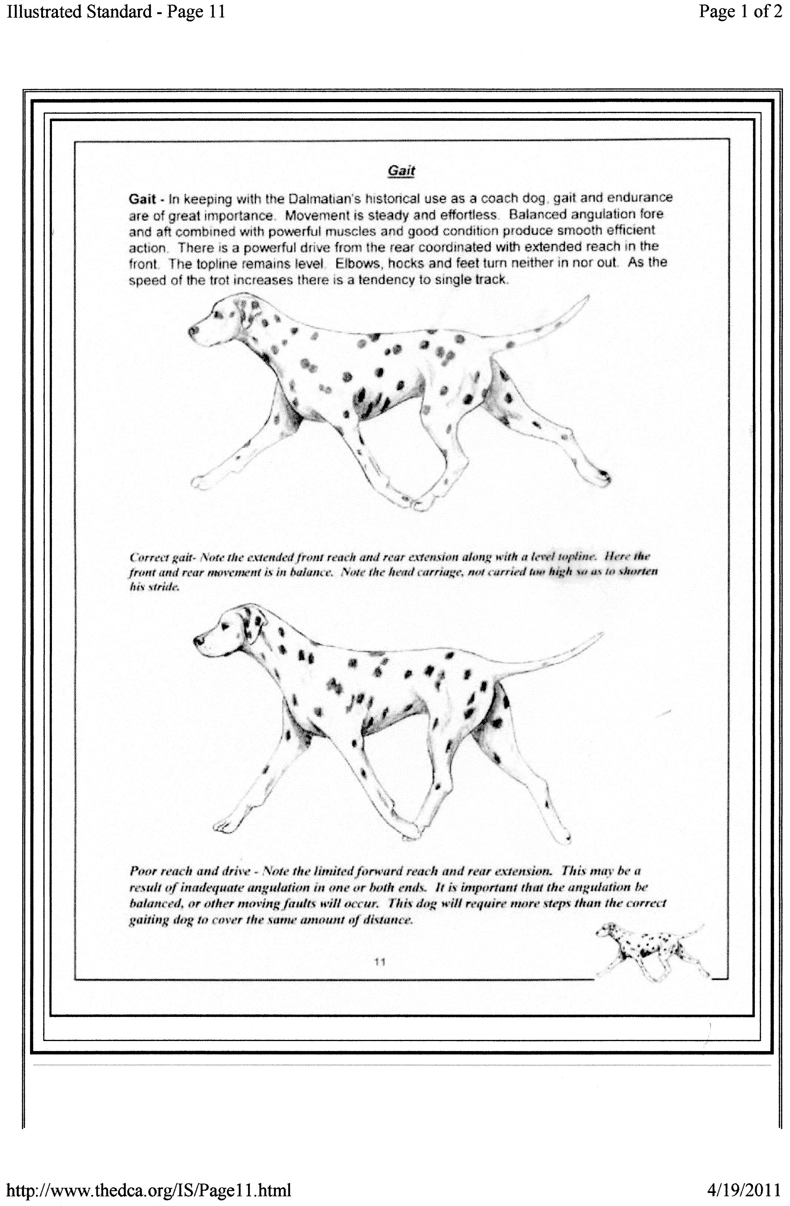
Gaiting

Slide 28
SCALE OF POINTS— COMPARISON OF 1962 AND 1989 AKC STANDARDS
1962 1989
General Appearance 5
Body, back, chest & loin 10 Neck, topline, body 10
Coat 5 Coat 5
Head and eyes 10 Head 10
Legs and feet 10 Feet 5
Neck & shoulders 10 Forequarters 5
Hindquarters 5
Ears 5
Size, symmetry, etc 10 Size, proportion, substance 10
Tail 5
Color & Markings 25 Color & Markings 25
Gait 10 Gait 10
Temperament 10

Slide 30
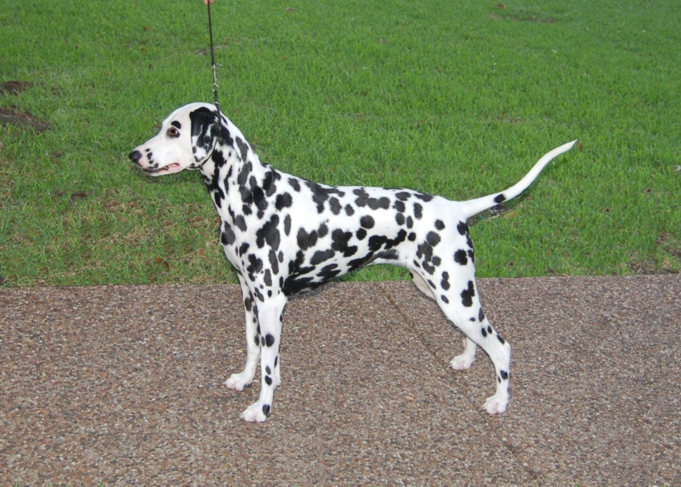
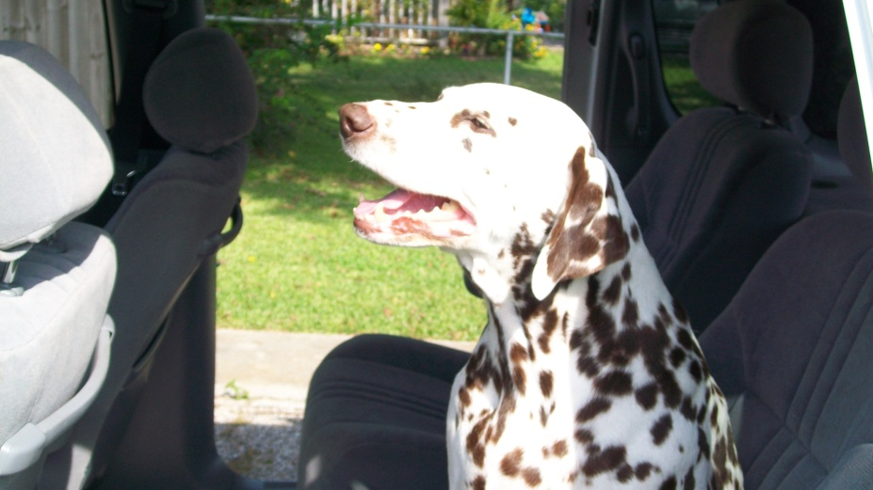
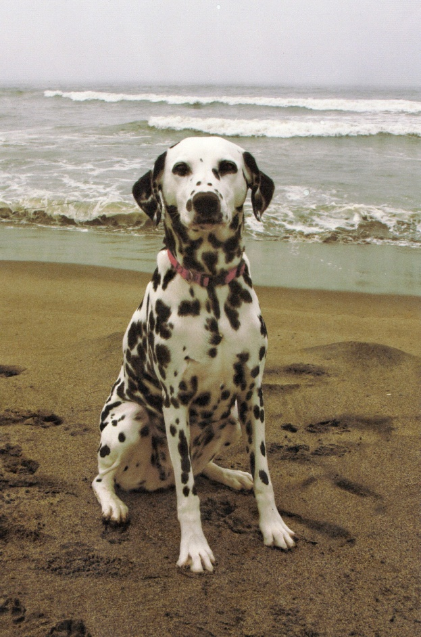
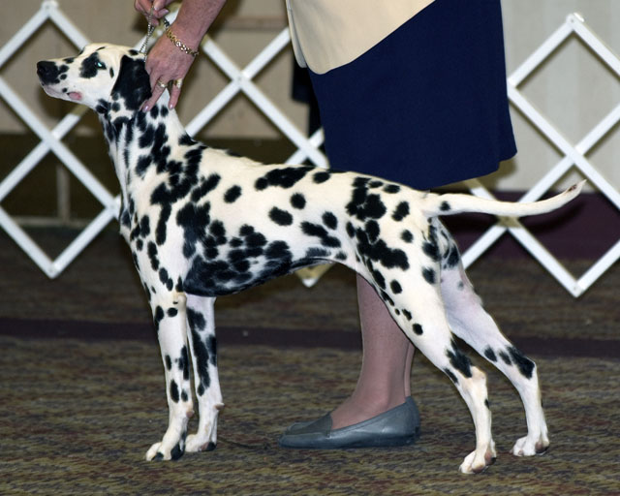
American Dals

Slide 31
Major Components of Dalmatian Type
Correct body shape and outline.
Steady & effortless movement with powerful drive from the rear and extended reach in the front.
Spotting

Slide 32
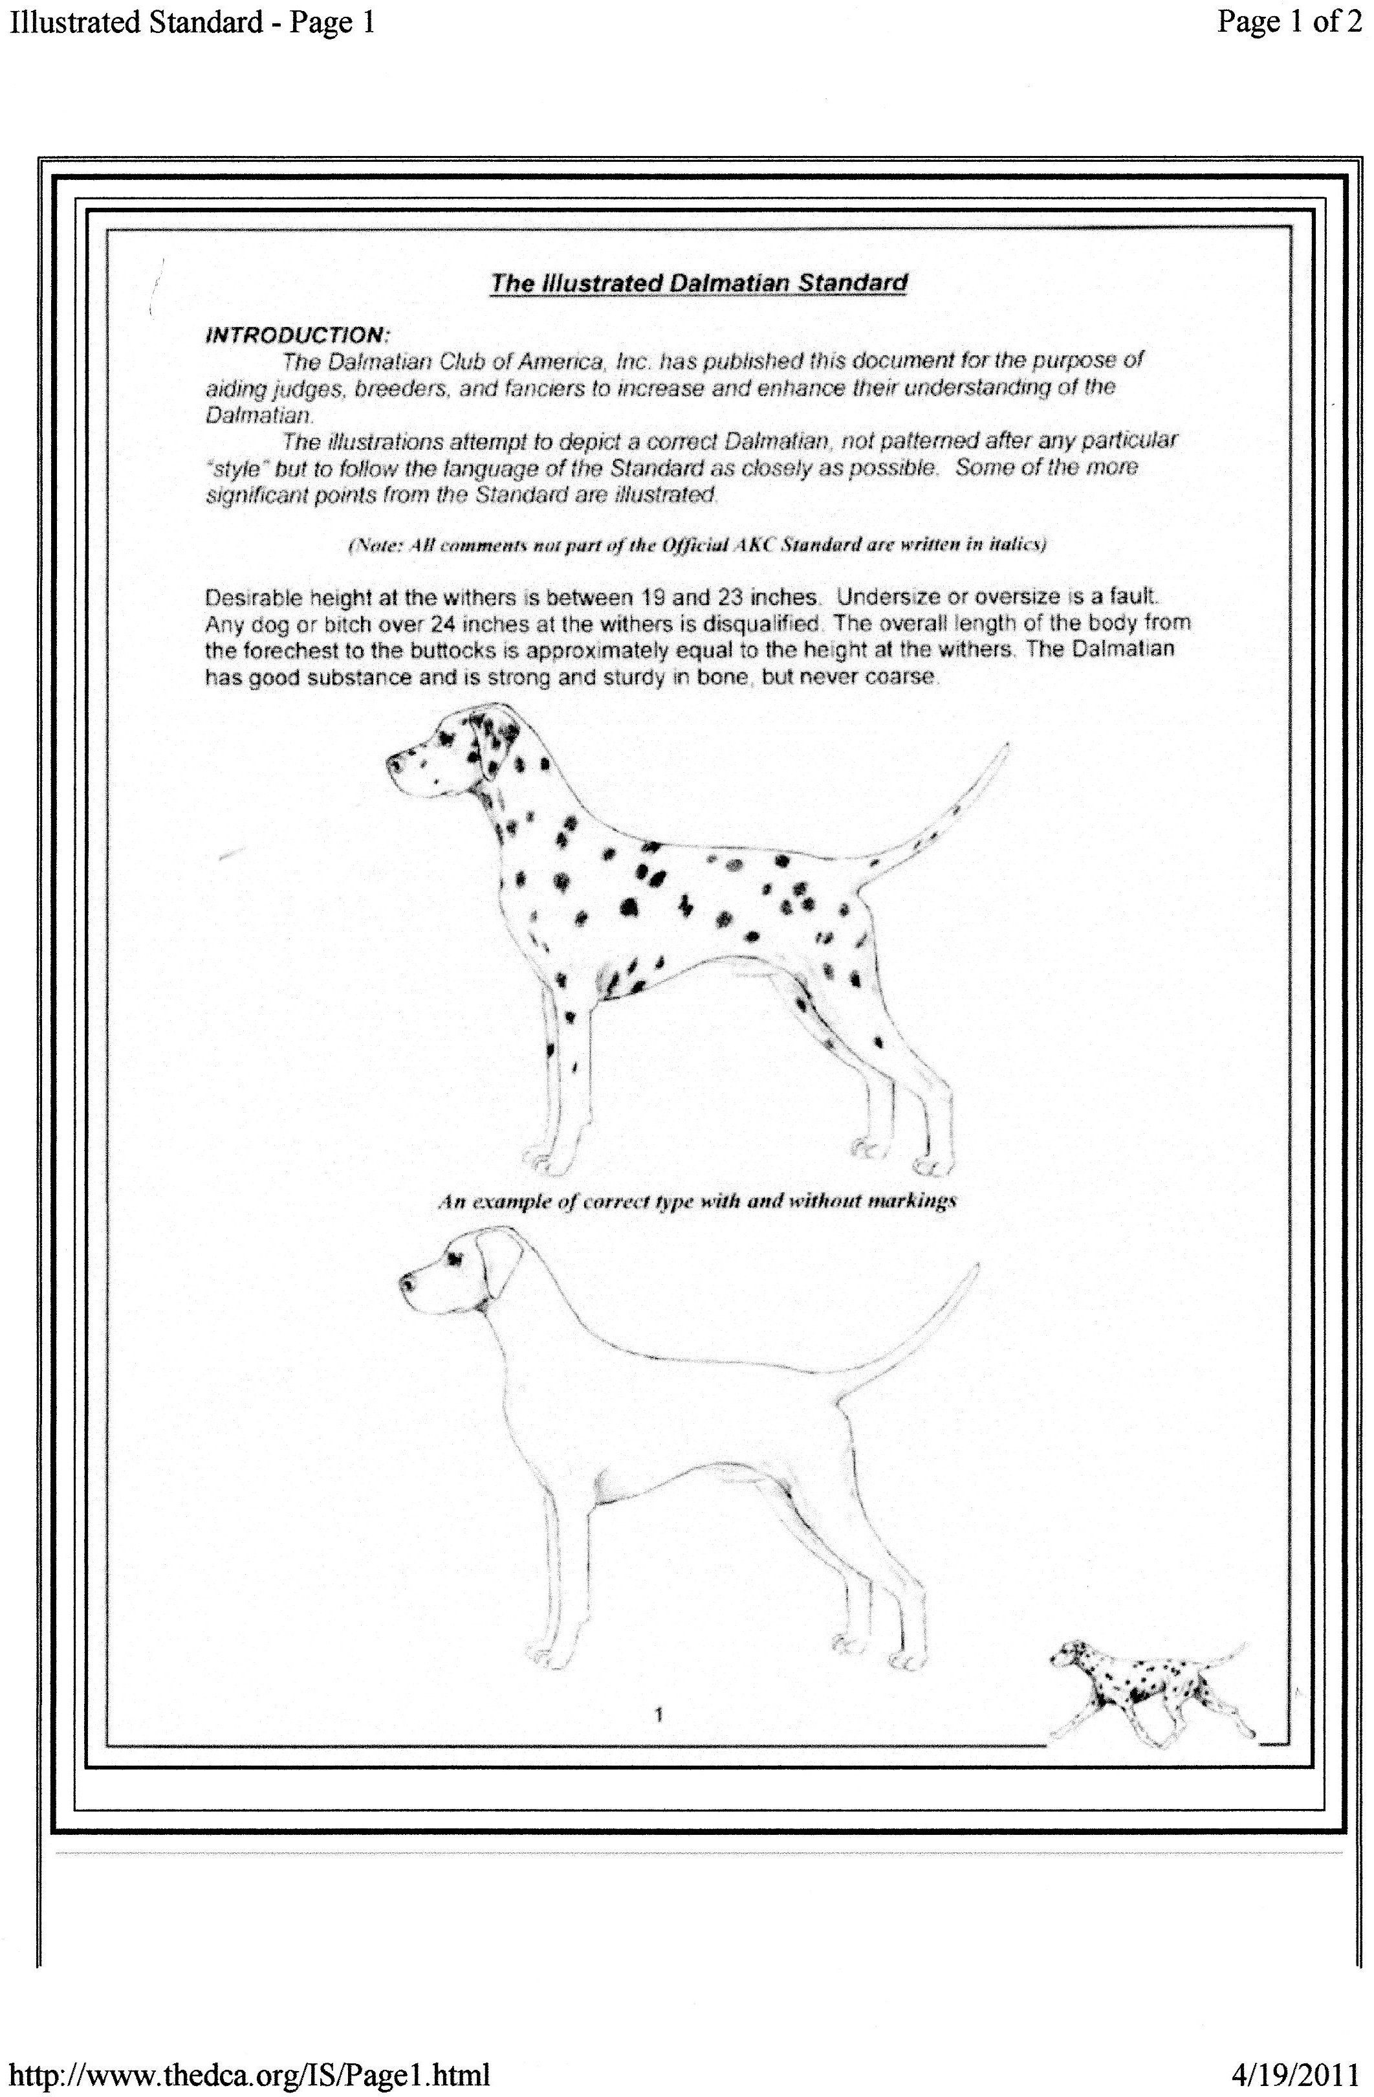
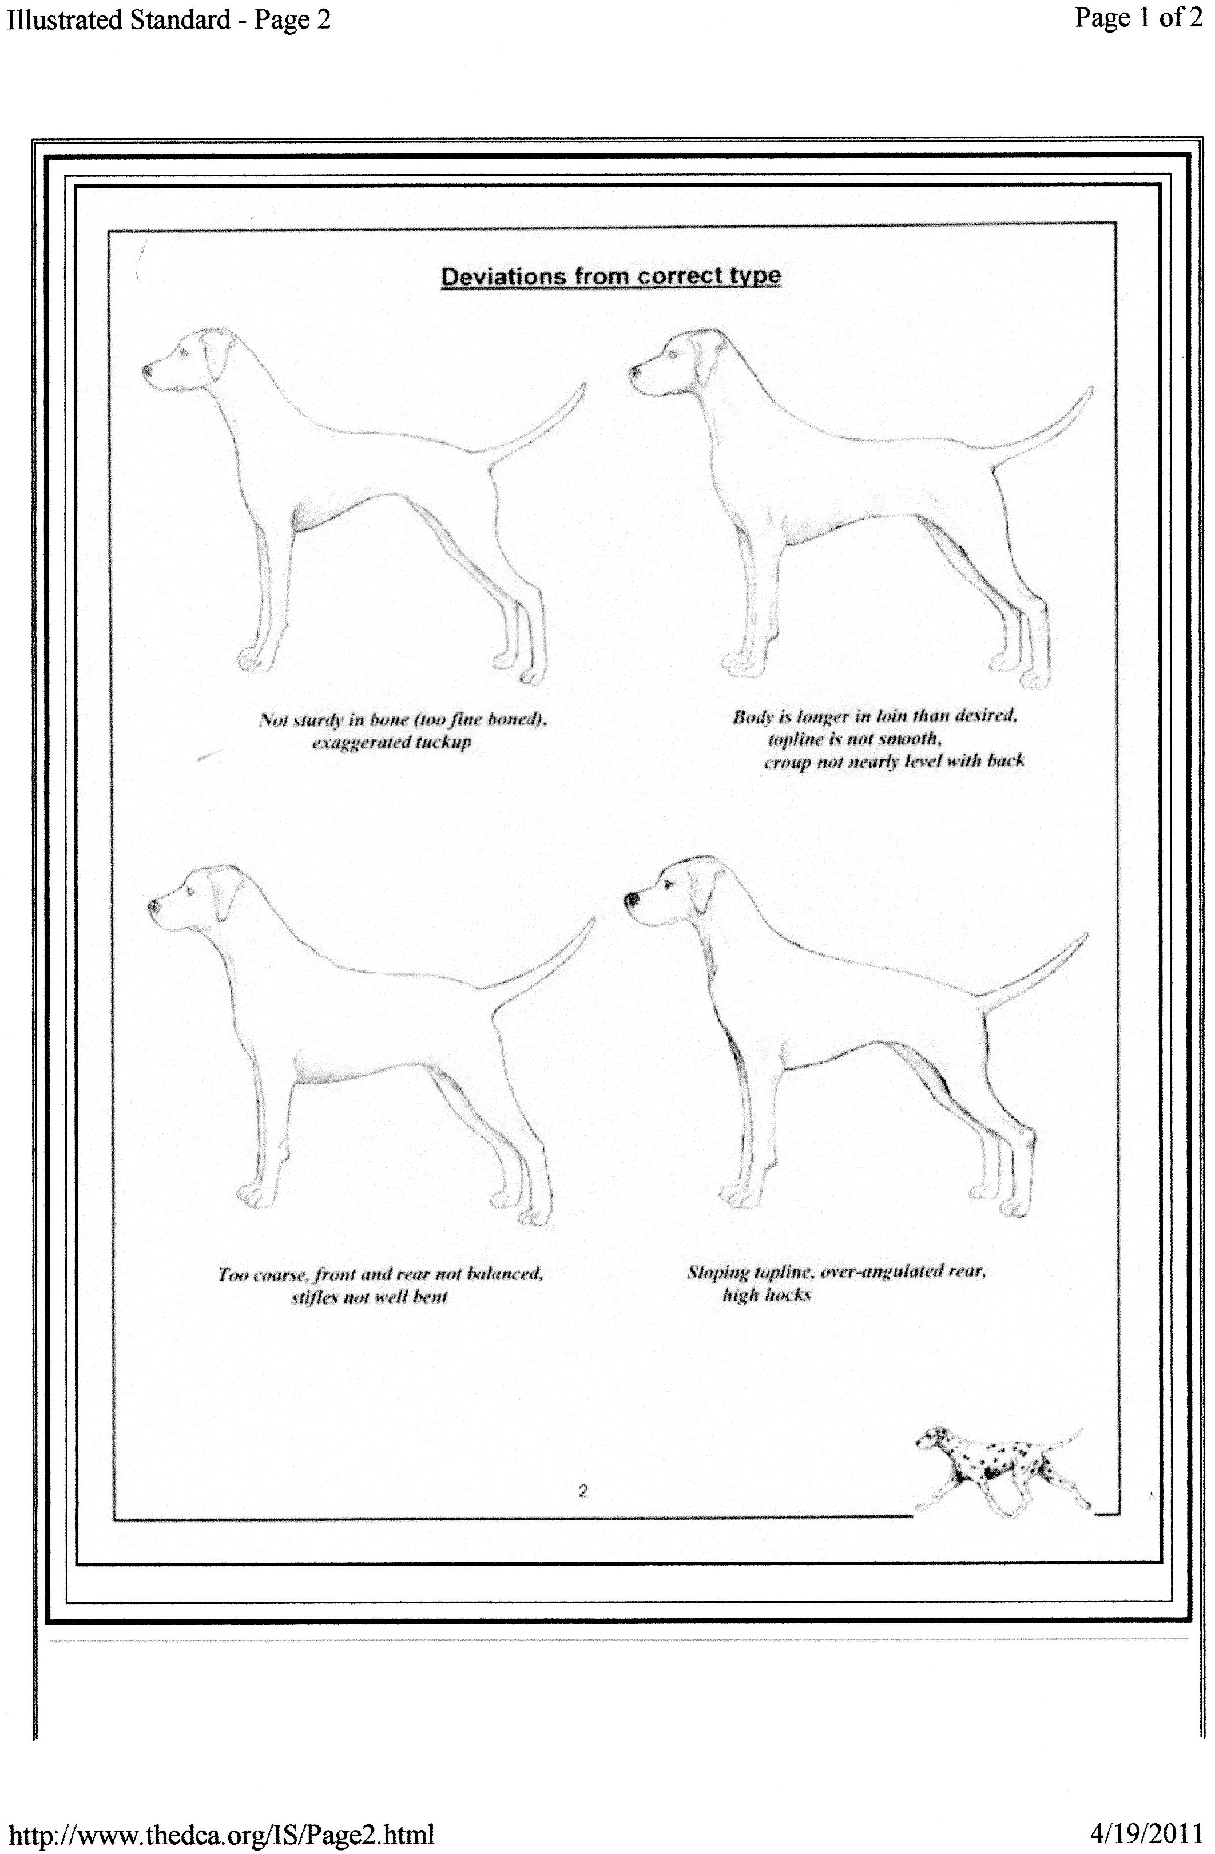

Slide 34
And the Answer is: (ALL)
American English Coonhound
Black & Tan Coonhound
Bluetick Coonhound
Plott Hound
Redbone Coonhound
Treeing Walker Coonhound
The coloring and size separates all these breeds.

Slide 35
”The overall length of the body from the forechest to the buttocks is approximately equal to the height at the withers. (AKC) The correct relationship of length of body to height at withers is 10:9, making the breed slightly longer than tall. (UKC)

Slide 36
Specific Differences in UKC Standard vs. AKC Standard
The correct relationship of length of body to height at withers is 10:9, making the breed slightly longer than tall.
Serious Fault: Patches. They should be faulted in proportion to the degree that they vary from the ideal description of spots. (Not a disqualification)
Serious Fault: Over 24 inches at withers. (Not a disqualification)
Eliminating Faults: Blue eyes. Eyes of two different colors. (An eliminating fault is a fault serious enough that it eliminates the dog from obtaining any awards in a conformation event)
Disqualifications: Unilateral or bilateral cryptorchid. Viciousness or extreme shyness. Overshot or Undershot bite. Any color other than black or liver. Tri-color. Lemon-colored spots. Albinism.
**The UKC Standard was revised May 1, 2010.

Slide 37
Specific Differences in Canadian Standard vs. AKC Standard
Liver spots should be of a colour closer to chocolate than to tan.
The tail should preferably be spotted.
The ears should be spotted, the more profusely the better; solid black or liver is undesirable.
Blue or partly blue eyes are undesirable and should be penalized.
Disqualifications—Patches
No Disqualification for:
Over 24 inches*
Tricolour*
Undershot or Overshot bite*
* These traits were disqualifications in the 1993 version of the Canadian Standard.
Approved 2009

Slide 38
SCALE OF POINTS—COMPARISON OF AKC & Canadian Standards
Canada 2009 AKC 1989
General Appearance 10 General Appearance 10
Size, Symmetry & Substance 10 Size, Proportion, Substance 10
Head & Eyes 10 Head 10
Ears 5
Neck & Shoulders 10 Neck, topline, & body 10
Body, Back, Chest & Loins 10
Legs & Feet 10 Forequarters 5
Hindquarters 5
Gait 15 Gait 10
Tail 5 Temperament 10
Coat, Colour, Markings 15 Coat 5
Color and Markings 25

Slide 39
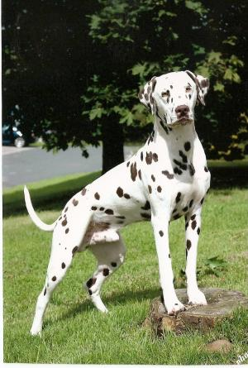
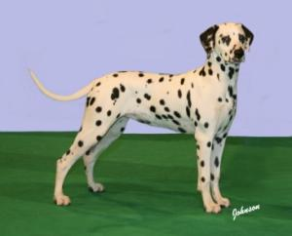
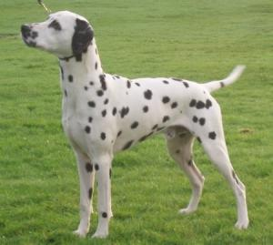
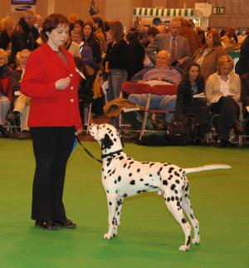
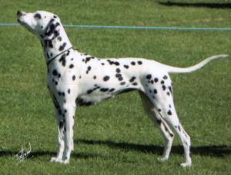
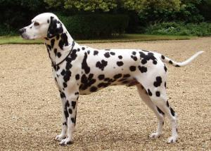
UK (England)

Slide 40
Specific Differences in English (UK) Standard vs. AKC Standard
NO DISQUALIFICATIONS
Head: …..”Distance from nose to stop equals that from stop to occiput…”
Forequarters: Shoulders well laid back, clean, muscular with length of shoulder and upper arm approximately equal…….
Body: Length from point of shoulder to point fo buttock slightly greater than height from withers to ground.
Hindquarters:……good turn of stifle, hocks well defined.
Tail:……Preferably spotted
Colour: …….Some patching on ears and head not to be penalized.
Elimination of the scale of points, in 1968
***Last updated—November 2010

Slide 41
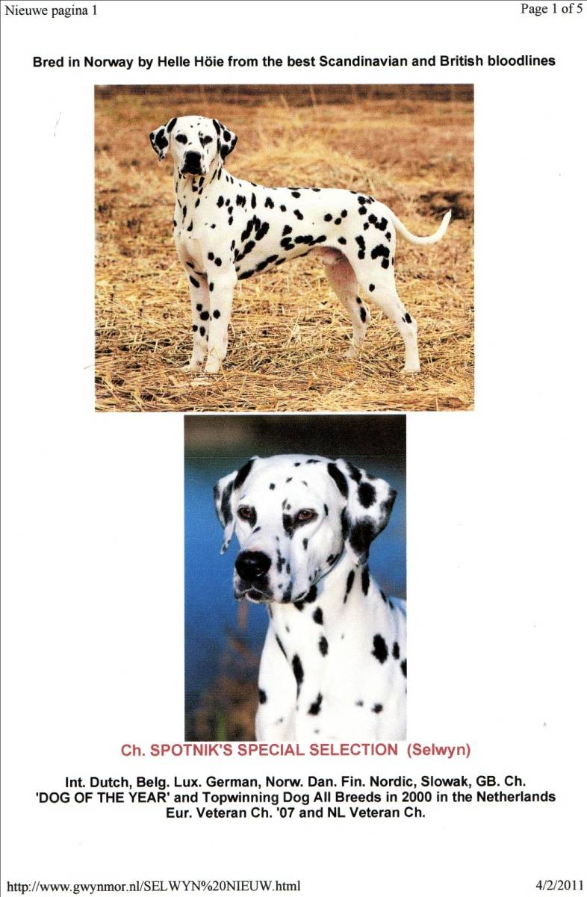
Book photo

Slide 42
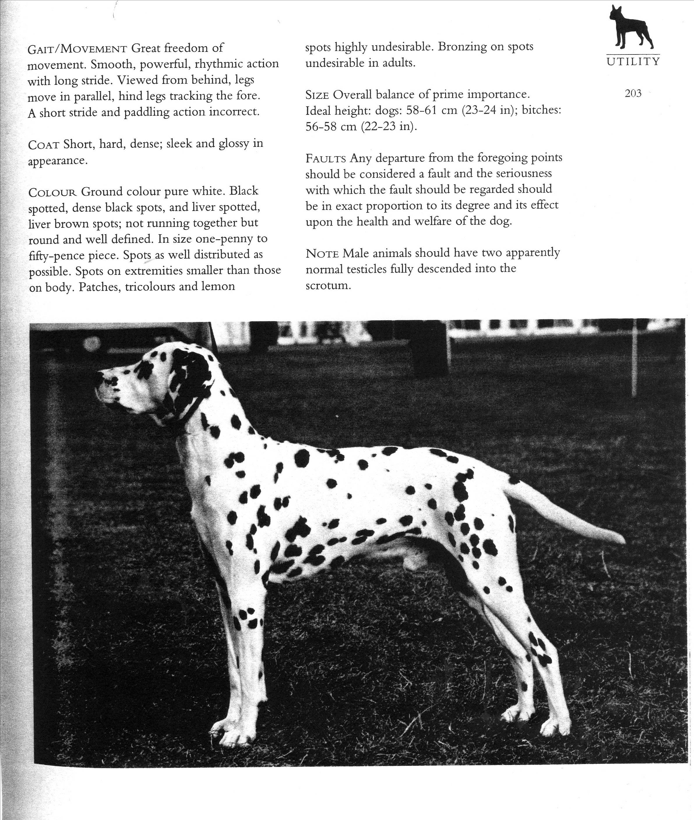
UK Book

Slide 43
Crufts-Best of Breed

Slide 44
Australia
Breed Standard
Plus Breed Extension by National Dalmatian Council
(Breed extension serves to clarify and expound on the standard.)
Clubs/ Governing body:
Dalmatian Club of NSW
Dalmatian Club of Queensland
Dalmatian Club of South Australia
Dalmatian Club of Victoria

Slide 45
Specific Differences in Australian Standard vs. AKC Standard
The Australian Standard contains a “Breed Extension” written by the National Dalmatian Council. “Breed Councils” are comprised of a group of experts who explain the standard in greater detail, and add clarifications to aid judges.
Eyes: (Included in Breed Extension) A dog with a blue eye should not be shown.
Body: (Included in Breed Extension) The Dalmatian is slightly longer than high from point of shoulder to point of buttock, withers to ground. The extra length of rib cage, not loin.
Gait/Movement: The Dalmatian should have great freedom of movement. A smooth, powerful rhythmic action with a long stride.
Size: Overall balance of prime importance…NO DISQUALIFICATION FOR SIZE.
Faults: Blue eyes. Patches. Black and liver spots on the same dog (tricolours). Lemon spots. Bronzing and other faults of pigmentation.
***Last revised, January 1998.

Slide 46
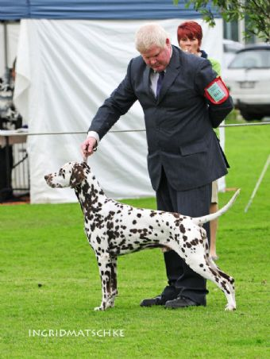
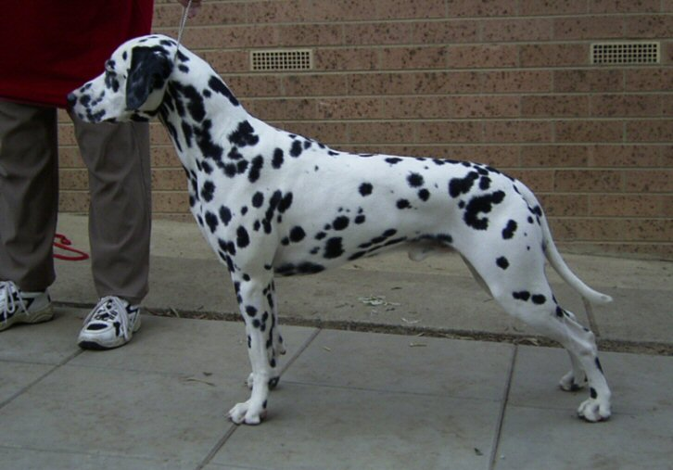
Australian Dogs

Slide 47
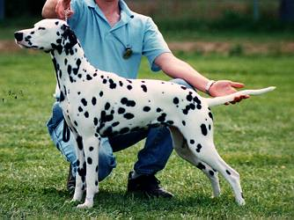
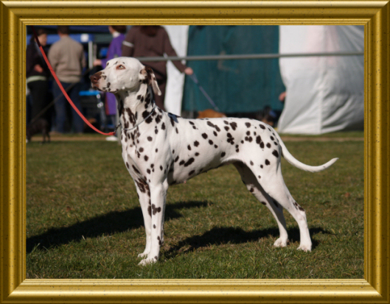
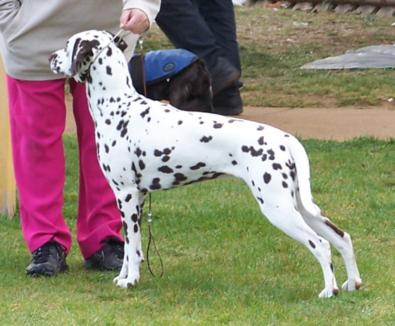
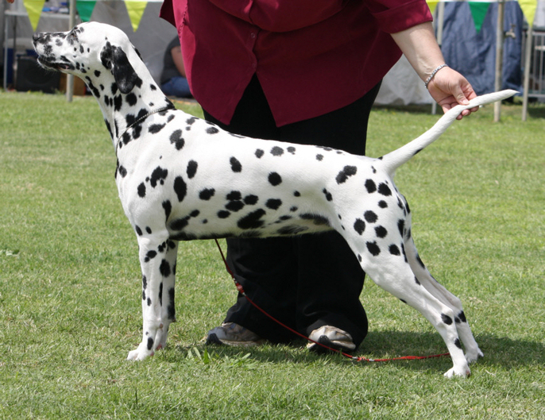
Australian Bitches

Slide 48
Specific Differences in FCI Standard vs. AKC Standard
The FCI Standard is very similar to the English and Australian Standards in most places. The word “Disqualification” does not appear, rather a list of “Eliminating Faults” appear at the end of the standard. These include:
1.Definitely over or undershot mouth.
2. Ectropion, entropion, walleyes, eyes of a different color (heterochromia).
3. Blue eyes.
4. Deafness.
5. Limited patching around eyes (monocle) or elsewhere, yet acceptable for breeding.
6. Tricolour.
7. Lemon.
8. Very timid or aggressive behaviour. (Note: There is no explanation of “Eliminating Faults” but I assume they are equal to a disqualification or no award given.)

Slide 49
FCI Commentary
Another document prepared by the European Cooperation of Dalmatian Clubs in 2001 provides commentary of each section of the FCI standard, very similar to the Australian “breed extension”.
At the end of the commentary, there are Recommendations for breeding to reduce the incident of deafness. The most interesting of these recommendations is:
“Dogs with pigmented scrotum should be preferred.”

Slide 50
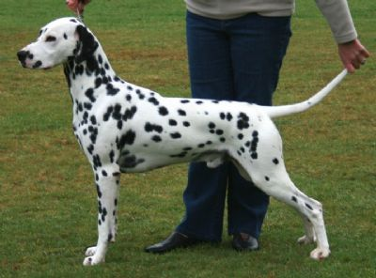
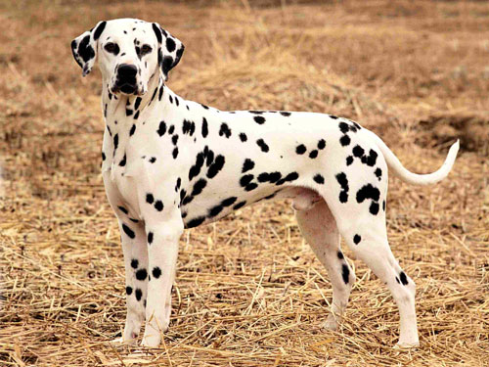
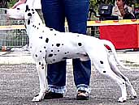
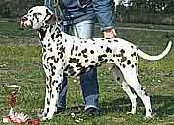
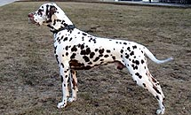
FCI Dogs

Slide 51
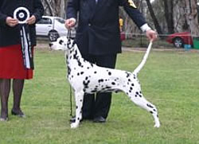
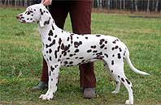
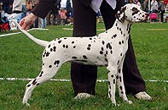
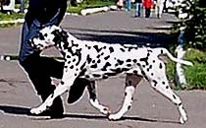
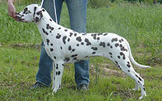
FCI Bitches

Slide 52
Diva- Top Dal Norway 2010

Slide 53
Reminders from the Past & Present
Excerpt from The Dalmatian by Fred Lauer, 1907 p.38:
“Spotting is all well enough is we are merely to consider the Dalmatian as a dog about the premises, but if we undertake to judge him as a coach dog the principle requirements should be conformation, so he can stand to run with a team, as a coach dog is supposed to do. “
Thought from the Present:
“he is pleased to see the Dalmatian, with its height disqualification in the United States, maintain its medium size and elegance that he feel can be lost when dogs get too big”
Rob Lawson; The Spotter, Winter 2010/2011, pg 19

Slide 54
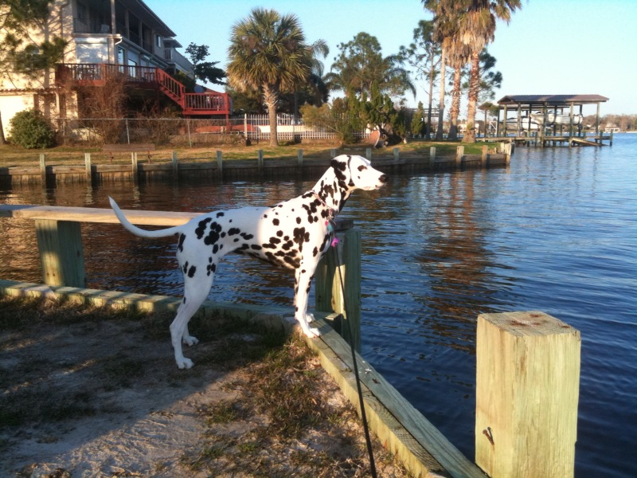
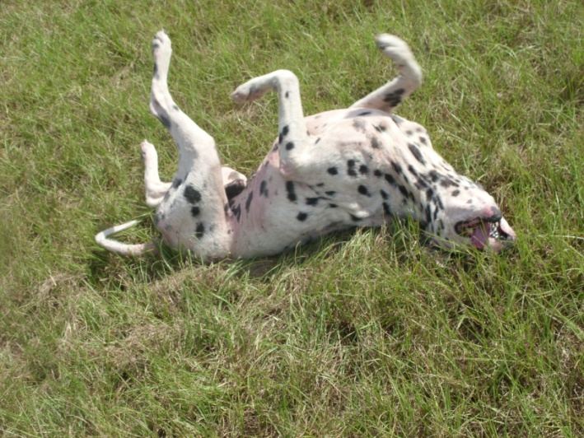
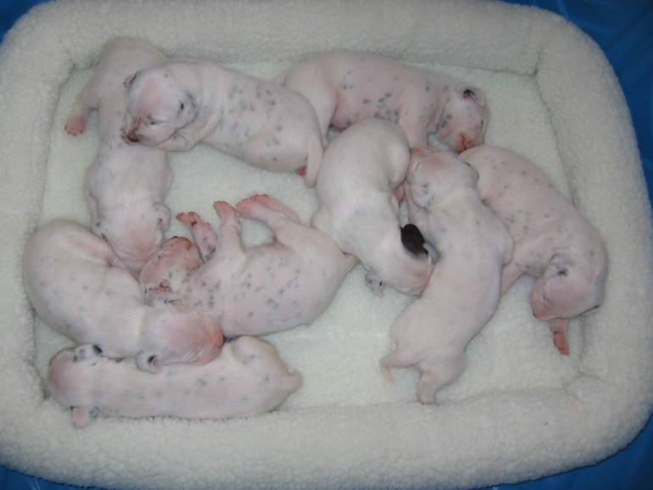
American Dals (cont)

Slide 55
Thank you!!
Acknowledgement:
Cheryl Steinmetz, DCA Historian
Scott Facey
Mr. Jim Crowley, AKC Executive Secretary
Gwen Barger
Mari-Beth O’Neill, AKC
Dr. David G. Doane, member of the 1962 standard committee.

